Slide 1
Geometrically Constrained Path Planning for Mobile Robot Cooperation
Neil Abcouwer and Priya Deo
December 10, 2013
16-811-F13

Slide 2
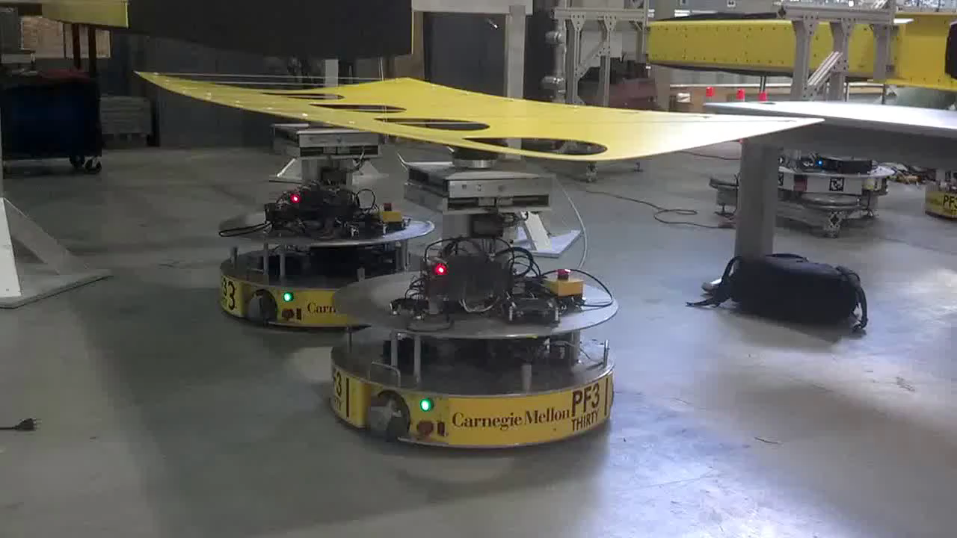
Objective
Create planning algorithms for robots working together to carry large objects.

Slide 3
Path Planning
Simplification
Sampling
Roadmap Creation
Finding Shortest Path

Slide 4
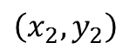
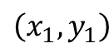

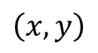
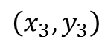
Simplification
Reduce several robots carrying a structure together into one agent with certain geometric constraints, to reduce the dimensionality of the problem.
$$\left(x_{2},y_{2}\right)$$
$$θ$$
$$\left(x_{1},y_{1}\right)$$
$$\left(x,y\right)$$
$$\left(x_{3},y_{3}\right)$$

Slide 5
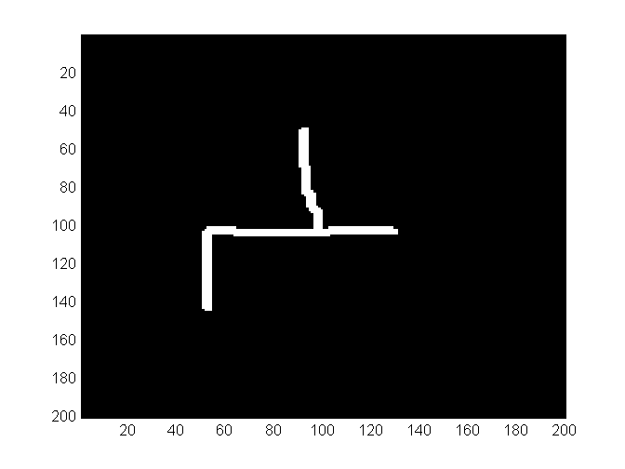
Sampling the Configuration Space
Start with a representation of the space to explore.

Slide 6
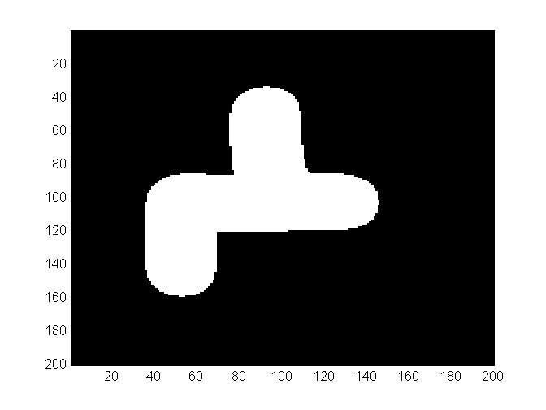
Sampling the Configuration Space
Extend the obstacles by the radius of the robots, then planning with simple point masses is possible.

Slide 7
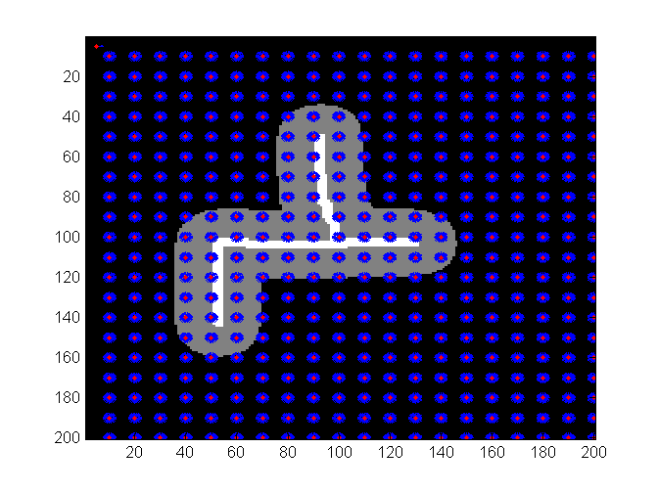
Sampling the Configuration Space
Uniformly sample the space at the desired resolution in x, y, and θ.

Slide 8
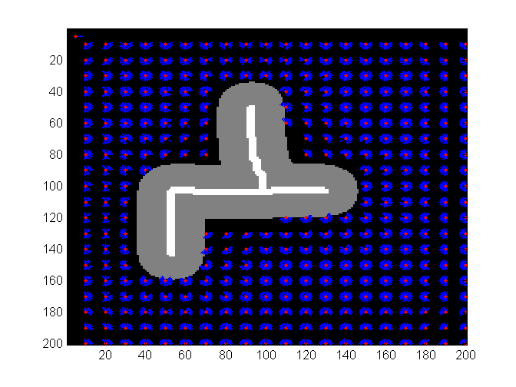
Sampling the Configuration Space
Reject the samples that collide with the primary point, and spaces that collide with the secondary points for some θ.

Slide 9
Creating a Visibility Map
Create a matrix to represent the graph to explore.
Connect each sample within a certain distance

Slide 10
Creating a Heursitic
The Heuristic is used to direct the graph search. For each node, find the distance to the goal configuration.

Slide 11
Use A* Algorithm
Find shortest path by sampling unexplored neighbors with lowest combined cost of path from start to node and cost of heuristic from node to finish.

Slide 12
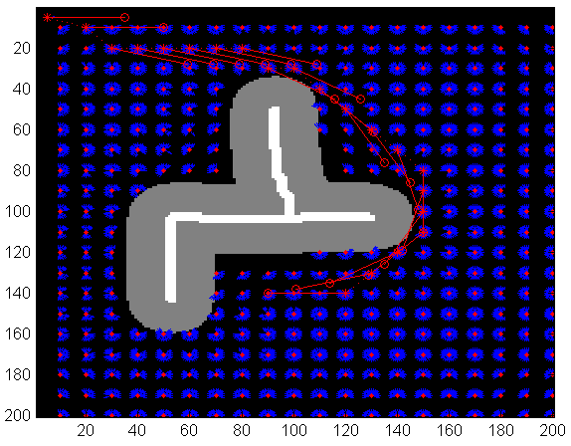
Results

Slide 13
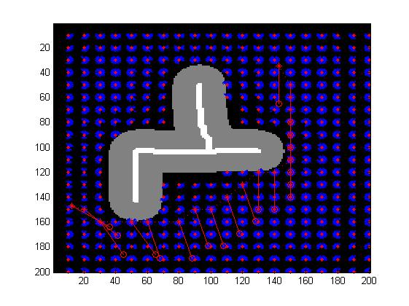
Using Different Heuristics
Penalizing Rotation

Slide 14

Using Different Heuristics
Penalizing Robot Movement

Slide 15
Future Work
D* for dynamic obstacles

Slide 16
Questions?

